Slide 1
Data Structures
Jiexin Wang
School of Software Engineering
South China University of Technology

Slide 2
Terminology
Abstract Data Type (ADT)
  Mathematical description of an object with set of operations on the object. Useful building block. （Abstract Data Type(ADT) is a data type, where only behavior is defined but not implementation.）
  An abstract data type could be defined as a mathematical model with a collection of operations defined on it. A simple example is the set of integers together with the operations of union, intersection defined on the set.
Data structure
  A specific family of algorithms for implementing an abstract data type.
Implementation of data structure
  A specific implementation in a specific language
Algorithm
  A high level, language independent, description of a step-by-step process

Slide 3
Terminologies (II)
A data structure is the physical implementation for an ADT.
  (C++) An ADT and its implementation together make up a class.
  Each operation associated with the ADT is implemented by a member function or method.
  The variables that define the space required by a data item are called data members.
  An object is an instance of a class – created during the execution of a computer program.

Slide 4
Terminologies (III)
/* The ADT for a list */
template <typename E> class List { // List ADT
// Clear contents from the list, to make it empty.
virtual void clear() = 0;
// Insert an element at the current location.
// item: The element to be inserted
virtual void insert(const E& item) = 0;
// Remove and return the current element.
// Return: the element that was removed.
virtual E remove() = 0;
// Move the current position one step right. No change
// if already at end.
virtual void next() = 0;
// Return: The number of elements in the list.
virtual int length() const = 0;
// Return: The position of the current element.
virtual int currPos() const = 0;
};

Slide 5
Algorithms vs Programs
Proving correctness of an algorithm is very important
  a well designed algorithm is guaranteed to work correctly and its performance can be estimated
Proving correctness of a program (an implementation) is fraught with weird bugs
  Abstract Data Types are a way to bridge the gap between mathematical algorithms and programs

Slide 6
Pseduocode
In the lectures algorithms will be presented in pseudocode。
  This is very common in the computer science literature
  Pseduocode is usually easily translated to real code
  This is programming language independent

Slide 7
Self-reading
Chapters1- Programming: A general overview
Important sections:
  Section 1.2 on Mathematic Review
  Section 1.3 on Recursion
  Section 1.6 on Templates

Slide 8
Chapter 2
Algorithm Analysis

Slide 9
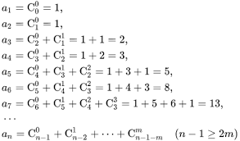
Algorithm Analysis: Why?
Correctness:
  Does the algorithm do what is intended.
Performance:
  What is the running time of the algorithm.
  How much storage does it consume. (Recursion v.s Iteration)
Different algorithms may correctly solve a given task
  Which should I use?

Slide 10
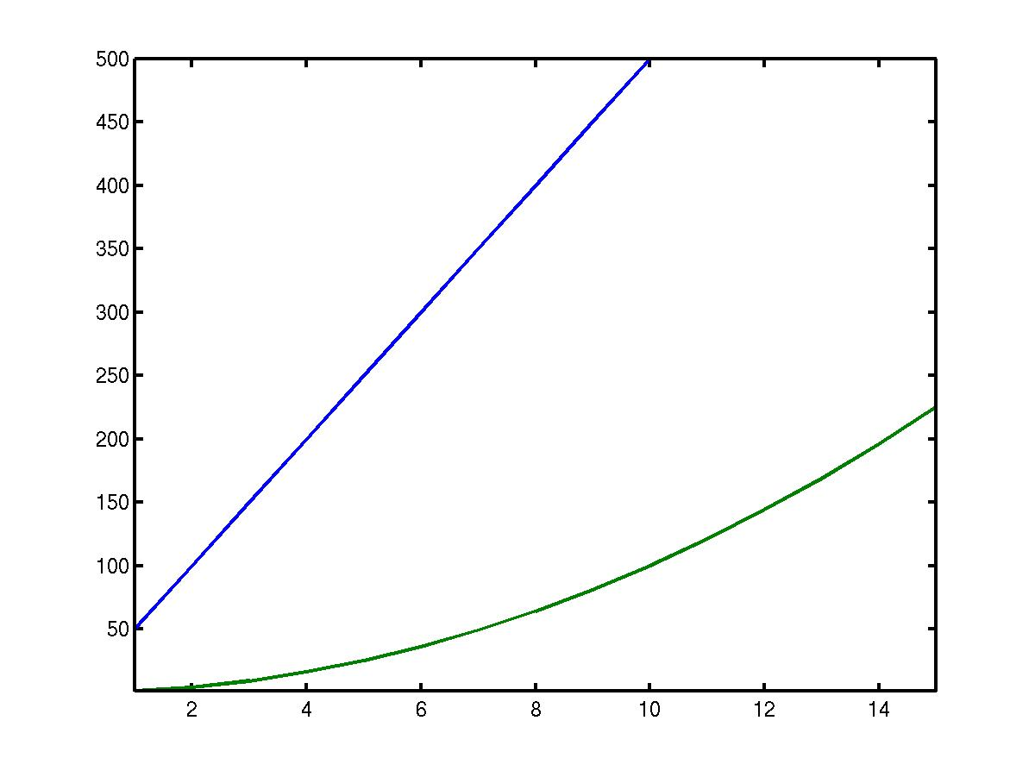
Algorithm Analysis
1. Why do we analyze algorithms?
  Suppose you are given two algorithms A and B for solving a problem.
  The running times T_{A}(N) and T_{B}(N) of A and B as a function of input size N are given
T_{A}
Run Time
T_{B}
Input Size N
Which is better?

Slide 11
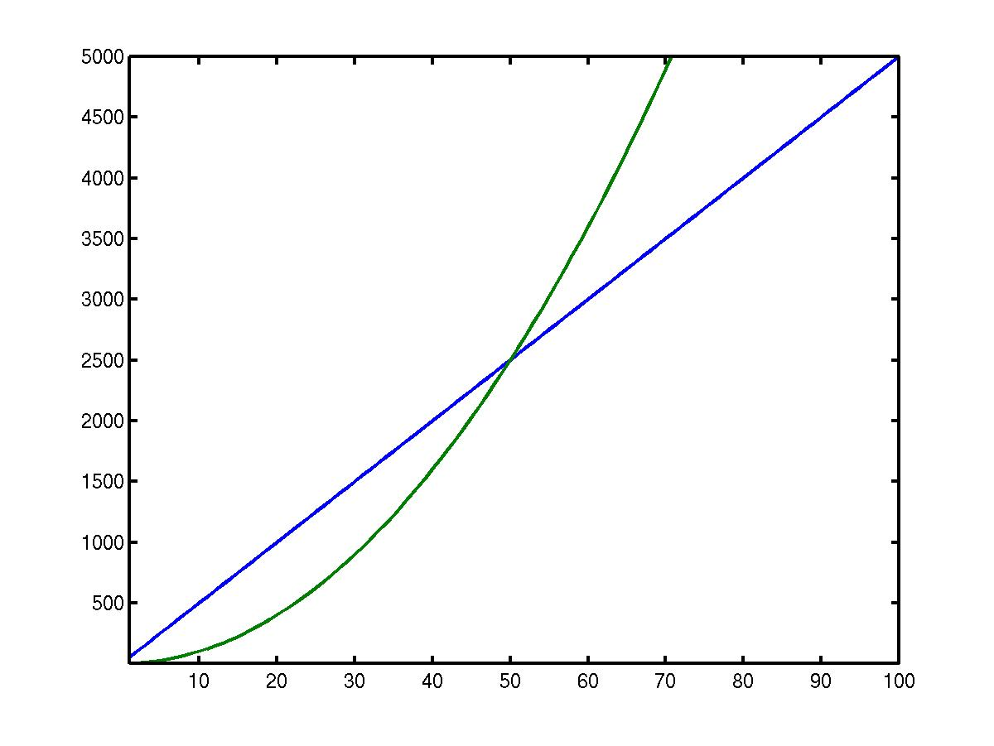
Algorithm Analysis
1. Why do we analyze algorithms?
For large N, the running time of A and B is:
Run Time
T_{A}(N) = 50N
T_{B}(N) = N²
Input Size N
Now which algorithm would you choose?

Slide 12
Algorithm Analysis
1. Why do we analyze algorithms?
2. How do we measure the efficiency of an algorithm?
  A. Time it on my computer.
  B. Compare its time to that of another algorithm that has already been analyzed.
  C. Count how many instructions it will execute for an arbitrary input data set.

Slide 13
Algorithm Analysis
Suppose there are n inputs.
We’d like to find a time function T(n) that shows how the execution time depends on n.
T(n) = 3n + 4
T(n) = e^{n}
T(n) = 2

Slide 14
What to Analyze
What to Analyze
  Running time required
  Memory or disk space required to run the program and store the data structure
Main factors
  the algorithm used
  the input to the algorithm
  Not include the programming language, compiler,…
Analyze the algorithms rather than the programs

Slide 15
Mathematical Definitions
T(N) = O(f(N)) if there are positive constants c and n₀ such that T(N) ≤ cf(N) when N ≥ n₀.
upper bound
Big-Oh
Big-Omega
Big-Theta
Little-oh
T(N) = Ω(g(N)) if there are positive constants c and n0 such that T(N) ≥ cg(N) when N ≥ n0.
lower
bound
T(N) = Θ(h(N)) if and only if T(N) = O(h(N)) and T(N) = Ω(h(N)).
T(N) = o(p(N)) if, for all positive constants c, there exists an n₀ such that T(N) < cp(N) when N > n₀.

Slide 16
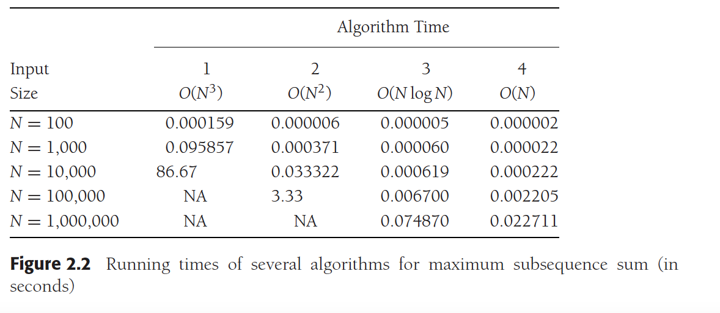
“Common Functions to Use”
O(1) constant
O(log n) log base 2
O(n) linear
O(n log n)
O(n²) quadratic
O(n³) cubic
O(2^{n}) or O(e^{n}) exponential

Slide 17
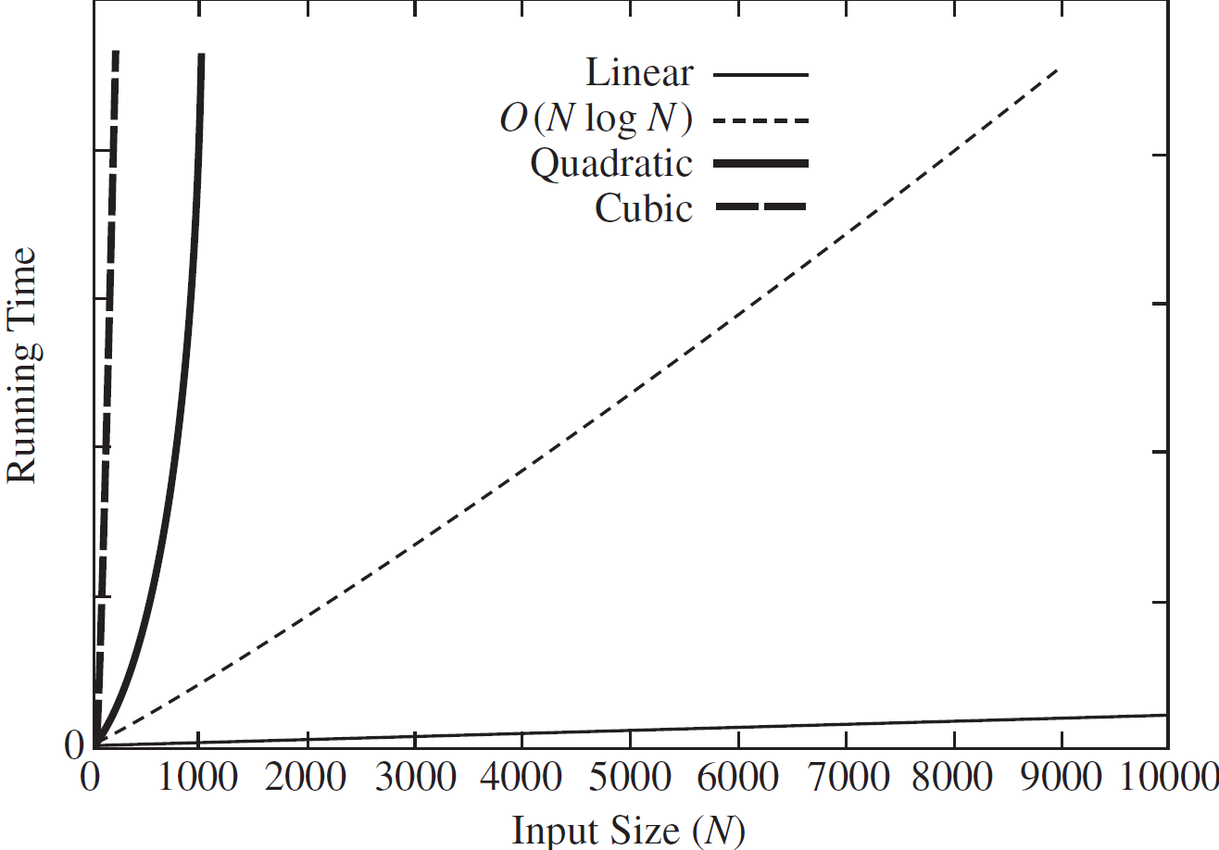
Growth Rates
The growth rate is the rate at which the cost of the algorithm grows as the input size grows
The idea of the definitions is to establish a relative order among functions.

Slide 18
“Big-Oh”
T(N) = O(f(N)) if there are positive constants
c and n₀ such that T(N) ≤ cf(N) when N ≥ n₀.
We say “T(N) has order f(N).”
“f(N) is an upper bound on T(N)”
We try to simplify T(N) into one or more common functions.
Ex. 1 T(N) = 3N + 4
T(N) is linear. Intuitively, f(N) should be N.
More formally,
T(N) = 3N + 4 ≤ 3N + 4N, N ≥ 1
T(N) ≤ 7N, N ≥ 1 （c=7，n₀ = 1）
So T(N) is of order N.

Slide 19
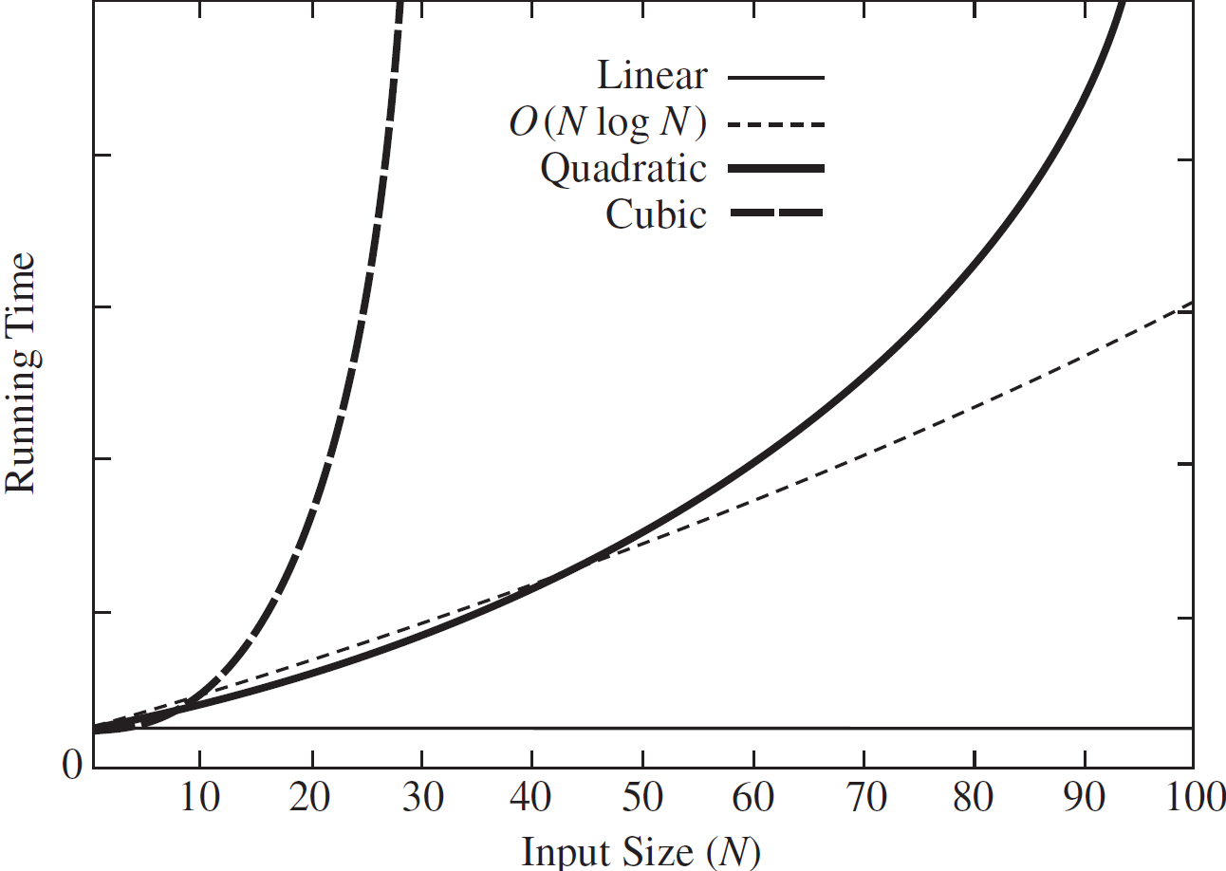
Growth Rates
The growth rate is the rate at which the cost of the algorithm grows as the input size grows
The idea of the definitions is to establish a relative order among functions.

Slide 20
“simplifying rules”
Rule 1: If T1(N) = O(f (N)) and T2(N) = O(g(N)), then
  T1(N) + T2(N) = O(f (N) + g(N))
  T1(N) ∗ T2(N) = O(f (N) ∗ g(N)).
Suppose we get T₁(N) = O(f(N)) and T₂(N)=O(g(N)),
f(N) = 4N² + 6, g(N) = 3N , T(N) = T₁(N)+T₂(N) =?
T(N) = T₁(N)+T₂(N) = O(f(N) + g(N))
= O(4N² + 3N + 6)
= O(N²)
intuitively O(max(f(N), g(N)))
比如4N² + N + 2<=5N² , when N>=2; i.e., c=5, n₀ = 2）

Slide 21
“simplifying rules”
Rule 2: If T(N) is a polynomial of degree k, then T(N) = Θ (N^{k}).
Rule 3: log^{k}N = O(N) for any constant k.
Rule 4: If T(n) = O(g(n)) and g(n) = O(h(n)), then T(n) = O(h(n)). – transitive*
Rule 5: If T(n) = O(kg(n)) for any constant k > 0, then T(n) = O(g(n)). – ignore the constant*.

Slide 22
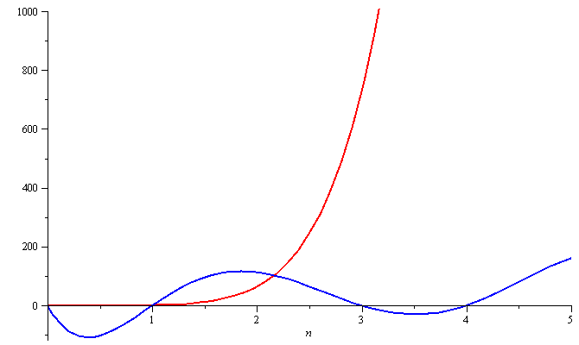
Growth Rates
To demonstrate with another example,
f(n) = n⁶ and g(n) = n⁶ – 23n⁵+193n⁴ –729n³+1206n² – 648n
Around n = 0, they are very different

Slide 23
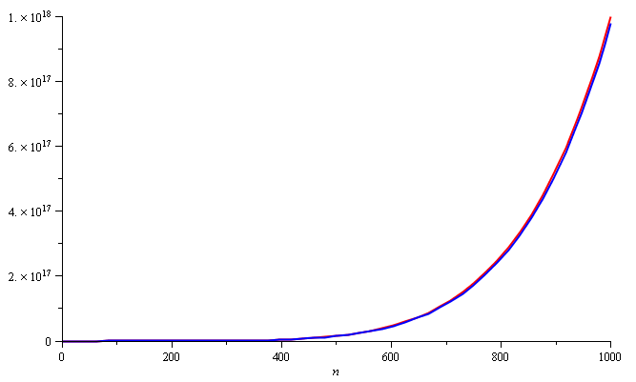
Growth Rates
Still, around n = 1000, the relative difference is less than 3%
Rule 2: If T(N) is a polynomial of degree k, then T(N) = Θ (N^{k}).
If T(N) = c_{k}N^{k} + c_{k-1}N^{k-1} + ... + c₀ .
T(N) = O(N^{k}).
N^{k} is the dominant term.

Slide 24
“Common Functions to Use”
Suppose we get T(N) = 4N² + 3N + 6.
Is T(N) = O(N²)?
Is T(N) = O(N³)?
Generally, we look for the smallest f(N) that bounds T(N).
We want a common function that is a least upper bound.

Slide 25
How to Analyze
How to analyze
  Asymptotic algorithm analysis
    Measures the efficiency of an algorithm, as the input size becomes large – growth rate.
    best-case
    average-case
    worst-case
, often of little interest
, often reflects typical behavior
, represents a guarantee for performance on any possible input.
Need to know enough about the input data distribution to do average-case analysis

Slide 26
How to Analyze
Given an array containing n integers, suppose the sequential search algorithm is adopted；c is the amount of time required to compare two integers。
Q1: The cost of finding the largest value
Always c*n
  Q2: The cost for finding a particular value K
  May be different for different inputs
Best case:
  if the first integer is K – examine 1 value
Worst case:
  if only the last integer is K – examine n values
Average case:
  If the sequential search is performed on different inputs for many times – examine n/2 values on average

Slide 27
How to Analyze
Step 1. Calculate T(N)
Step 2. Simplifying O(f(N))
//Loop
int sumit( int v[ ], int num) {
sum = 0;
for (i = 0; i < num; i++)
sum = sum + v[i];
return sum
}
c1
c2*num
c3*num
c4
T(num) = (c2 + c3)* num + (c1 + c4)
= k1 * num + k2
= O(num)
throw away leading constants
We say T(n) of the algorithm is in ≈O(n)

Slide 28
How to Analyze
// Nested Loops
int sum(int n) {
int sum = 0;
for (i=1; i<=n; i++)
for (j=1; j<=n; j++)
sum++;
}
c1
c2*n
c3*n²
c4*n²
T(n) = c1 + c2*n + c3*n² + c4*n²
= O(n²)
throw away low order terms
We say T(n) of the algorithm is in O(n²)

Slide 29

How to Analyze
// compare the cost of the two loop codes
sum = 0;
for(k=1; k<=n; k*=2)
for(j=1; j<=n; j++)
sum++;
//do log(n) times
//do n times
  In this double loop, the cost is
The algorithm is in O(n logn)

Slide 30
How to Analyze
// compare the cost of the two loop codes
sum = 0;
for(k=1; k<=n; k*=2)
for(j=1; j<=k; j++)
sum++;
//do log(n) times
//do k times
  In this double loop, the cost is
The algorithm is in O(n)

Slide 31
How to Analyze
// assume array A contains n values,
// random takes constant time c₁ and
// sort takes cnlogn steps
for (i=0; i<n; i++) {
for (j=0; j<n; j++)
A[j] = random(n);
sort(A, n);
}
Determine Θ in average case
Θ(n(c₁n+cnlogn))= Θ(n²logn)

Slide 32
How to Analyze
// assume A[] contains a random permutation
// of the values from 0 to n-1
sum=0;
for(i=0; i<n; i++)
for(j=0; A[j] !=i; j++)
sum++;
7 | 5 | 2 | 1 | 0 | 4 | 6 | 3
j=0
j=1
j=4
Determine Θ in average case
Θ(n*n/2)=Θ(n²)

Slide 33
How to Analyze
// A simple assignment to // an integer variable
a = b;
T(N) = Θ(1)

Slide 34
How to Analyze
While loop – similar to for loop
If-then-else statement – the greater of the costs for the then and else clauses.
Switch statement – the most expensive branch
Subroutine call – add the cost of subroutine
Recursive subroutine – express the cost by a recurrence relation and then find the closed-form solution.

Slide 35
How to Analyze
// Here || is the string concatenation operator
string t (int n){
if (n == 1) return ‘(1) ‘;
else return ‘(‘ || n || t(n - 1) || ‘) ‘
}
T(n) = T(n-1) + c , for n>1, with T(1) = c₁
That is ,
T(n) = c*(n-1) + c₁ = Θ(n)

Slide 36
How to Analyze
// Multiple Parameters
// A picture with P pixels; each pixel take one of C color
// values; Sort the colors w.r.t. the number of pixels with
// the color (Θ(C log C) )
for (i=0; i<C; i++) // Initialize count
count[i] = 0;
for (i=0; i<P; i++) // Look at all pixels
count[value(i)]++; // Increment count
sort(count); // Sort pixel counts
The cost is Θ (C) + Θ(P) + Θ(C log C) = Θ(P + C log C)
    Can we drop Θ(P) or Θ(C log C)?

Slide 37
Notes
Best, Worst, Average-Cases
vs.
Upper, Lower Bounds
U/L bounds refer to the algorithm’s growth rate.
B/W/A cases refer to a certain type of inputs which cause the shortest/average/longest running time among all the inputs in study.
U/L bounds can be used to describe the running time of an algorithm in its [best, worst, average] case

Slide 38
Notes
For an algorithm with T(n) = c₁n²+c₂n in the average case (c₁, c₂>0) ,
  c₁n²+c₂n <= (c₁+c₂)n² for all n>1, T(n) <= cn² for c=c₁+c₂ and n₀=1.
  c₁n²+c₂n >= c₁n² for all n>1, T(n) >= c₁n² for n₀=1.
  T(n) is in Θ(n²) in the average case
Reading the value from the first position in an array takes constant time regardless of the size of the array.
  T(n) = c for the (best, worst, and average) cases.
  Traditionally, we say that the algorithm is in O(1).

Slide 39
Notes
Analyze an algorithm
vs.
Analyze a problem
The upper bound for a problem cannot be worse than the upper bound for the best known algorithm
If a problem is in Ω(f(n)), every algorithm that solves the problem is in Ω(f(n)), even algorithms that we have not thought of.

Slide 40
Notes
Other kinds of analysis
  Amortized –worst case averaged over a sequential operations
  Textbook Chapter 11
  Common case – 80%-20%

Slide 41
Homework
Read textbook Ch2. Please pay more attention on section 2.4.3 “the Maximum Subsequence Sum Problem”
分别使用递归以及循环两种方法实现斐波那契数列，并进行时间复杂度分析（使用大O）
Exercise 2.7：运行时间分析（使用大O）
Exercise 2.20
提交：一个word文件或者markdown文件（包含题目内容，解答，注意2.20的判断素数函数代码也一起包含在word/markdown文件里）。

